Slide 1
centre léon bérard Comprehensive cancer center lyon, france

Slide 2
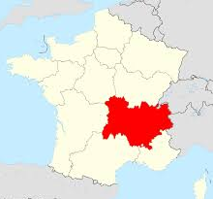


WHO WE ARE
A comprehensive Cancer Center with 3 core missions : Oncology Care, Research and Education.
The Leon Berard Cancer Center (referred as “CLB”) offers diagnostic examinations and cancer treatments in a single place : Lyon, France.
Recognized as a regional reference center in oncology by the French regional sanitation and health organizational plan (SROS)
Certified by the French High Health Authority (HAS) and the OECI (Organization of European Cancer Institutes)
LYON
Auvergne-Rhône-Alpes region has a population of 7.8 million inhabitants

Slide 3
WHO WE ARE
Private non-profit organization dedicated to cancer treatment
Affiliated to UNICANCER which groups together 18 French Comprehensive Cancer Centers (FCCC)
To fight against cancer, the CLB offers:
A multidimensional service: prevention, treatments, supportive care (psychologist, social support,…)
Access to innovation at every stage of medical management,
A management of cancer disease at the later stages.

Slide 4
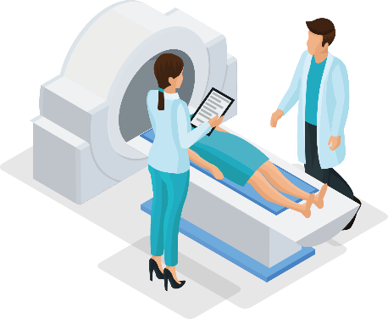




KEY NUMBERS
15.000
m² dedicated
To Research
2.208
employees
42.329 patients
3 operating units (classical, interventional, brachytherapy)
15 operating rooms
Radiotherapy Center with 8 accelerators
2 Pet Scan 3 gamma cameras, within 1 CT Veriton
An imaging platform
2 MRI scanners, 2 scanners, radiography units,
ultrasound equipment, 2 mammography units
700
researchers
300
doctors
900
Nurses
& auxiliary nurses
326
Beds &
outpatient beds
2.320
patients in clinical trials

Slide 5
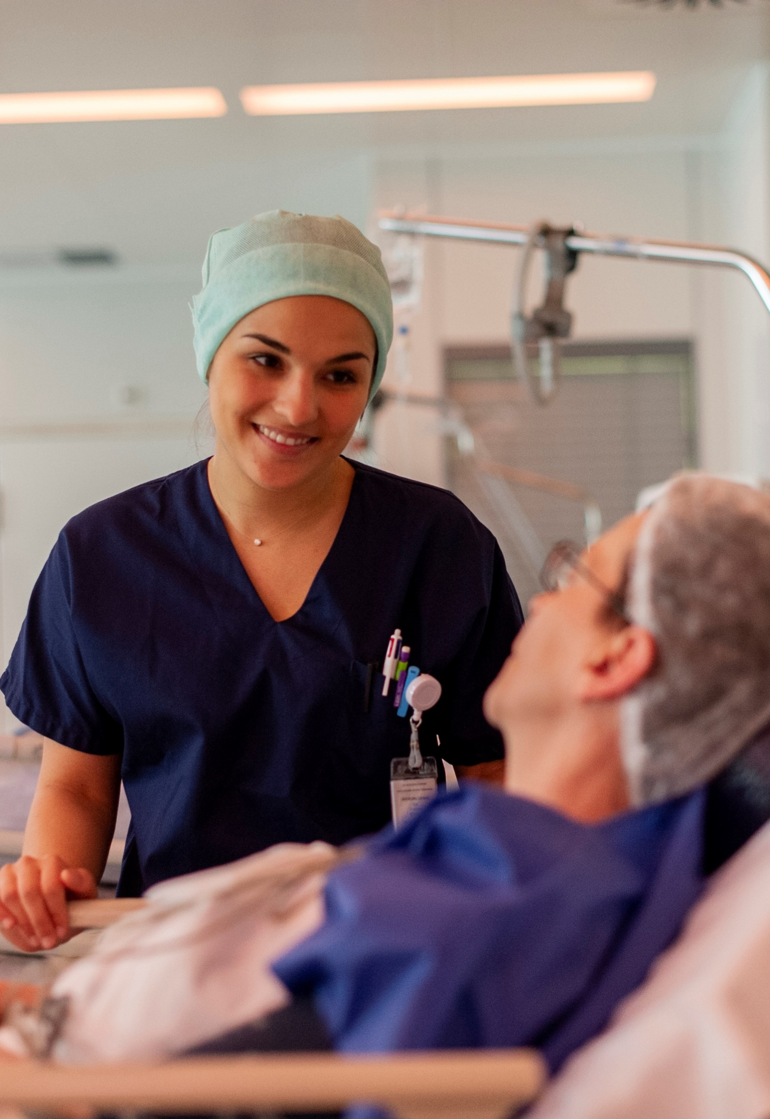
7 HIGHTECH PLATFORMS FOR CARE
One of the biggest Radiotherapy center in France
8 « accelerators » including 1 Cyberknife© (next-generation robotic radiosurgery system) and 2 TomoTherapy® systems.
One Surgery unit with 11 hightech operatory rooms
One medical imagery Unit (2 MRI, 2 CT-Scan…)
One interventional Unit with 3 rooms dedicated to interventional radiology and endoscopy.
One nuclear medecine Unit with 2 Pet Scan and 3 gamma camera
One brachytherapy Unit
One biopathology Unit

Slide 6
INTEGRATED ON-SITE RESEARCH
A strategic environment allowing us to convert basic research knowledge into clinical outcomes for the benefit of patients. Today, the CLB is a major actor of oncology research in Europe.
BASIC RESEARCH
TRANSLATIONAL
RESEARCH
CLINICAL
RESEARCH

